Slide 1
2022-23 Adopted Budget Summary Report
June 7, 2022

Slide 2
Agenda
Budget Cycle
State Budget Process
2022-23 General Fund Budget Assumptions
Revenues
Expenditures
2022-23 LCAP Revenues and Expenditures
2022-23 Adopted Budget Financial Summary and Multi Year Projection (MYP)
Next Steps

Slide 3
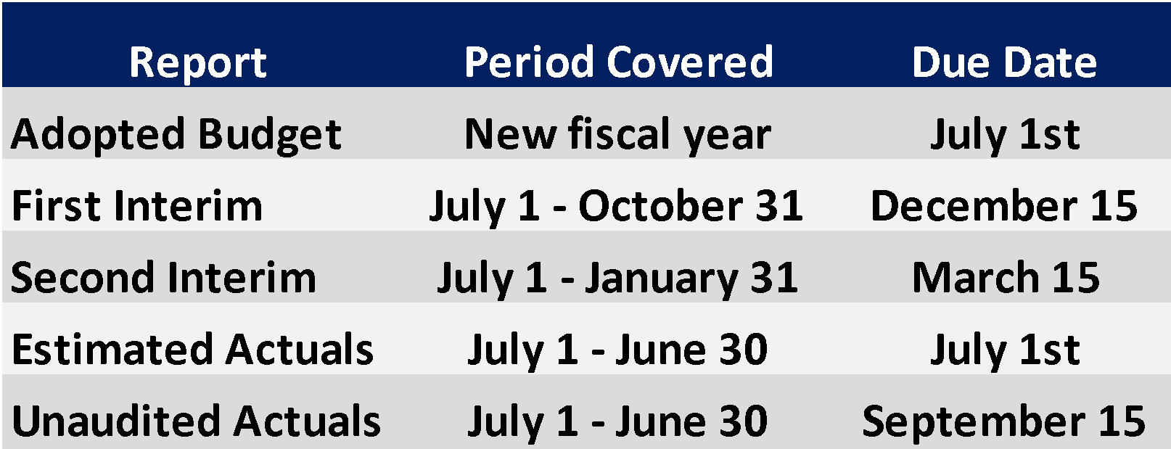
Budget Cycle and Fiscal Oversight
State law requires school districts to submit comprehensive financial reports aligned to the timeline below.
CDE requires submission of the reports utilizing SACS, a statewide, uniform financial reporting format.

Slide 4
State Budget Timeline
Governor: Budget Proposal by mid January
Governor: Revised Budget released by mid May
March
June
January
May
District: Review Estimated Actuals for 2021-22 and 2022-23 Budget on June 7th; Action on June 14th
Legislature: must pass a State budget by June 15th
Governor and Legislature: must adopt by June 30th

Slide 5
State Budget Process
Between the May Revise (May 15th) and Budget Adoption (June 30th), negotiations take place:
State Senate
State Assembly
Governor and his administration (i.e. Dept. of Finance, etc.)

Slide 6
State Budget Process
The State has collected more revenues than they expected.
The Senate, Assembly, and the Governor all have ideas about how to commit more dollars to education.
Competing priorities and opposing bills, all seek to use the same set of revenues.
We still don’t know how these negotiations are going to settle, so we can’t yet guarantee what kind of revenues and potential spending restrictions we may receive.

Slide 7
Budget Assumptions
What we know and what we’ve included in the Adopted Budget:
State will fund a sizeable COLA
District Revenues will be based on the higher of the following:
Current ADA
Prior Year ADA
3-Year Average of ADA*
All three State players (Senate, Assembly, Governor) have proposals to:
commit additional dollars to schools beyond the constitutional requirement
both one-time AND ongoing funds
raise the LCFF base grants, our primary source of revenue

Slide 8
Budget Assumptions
Average Daily Attendance (ADA)
Three year average option
Adjusted upward to include TK
Adjusted downward due to declining enrollment
Cost of Living Adjustment (COLA)
Three significant “Turn the Page” Costs
Step/Column Salary Increases
Pension costs: STRS/PERS
Health and Welfare Costs

Slide 9
Budget Assumptions: Revenues
 | 2022-23 | 2023-24 | 2024-25
Enrollment (-275 per year) | 29,274 | 28,999 | 28,724
Attendance Rate down from rate of 97+% historically | 96.9% | 96.9% | 96.9%
COLA* | 6.56% | 3.61% | 3.64%
Special Ed. Per Pupil Rate (AB602) up from previous rate of $715 per pupil | $820 | $820 | $820

Slide 10
Budget Assumptions: Expenditures
 | 2022-23 | 2023-24 | 2024-25
STRS Up from 16.92% in 2021-22 | 19.10% | 19.10% | 19.10%
PERS Up from 22.91% in 2021-22 | 25.37% | 25.20% | 24.60%
Step & Column for Salaries | 1% | 1% | 1%
Health and Welfare Benefit Cost Increases | 10% | 10% | 10%

Slide 11
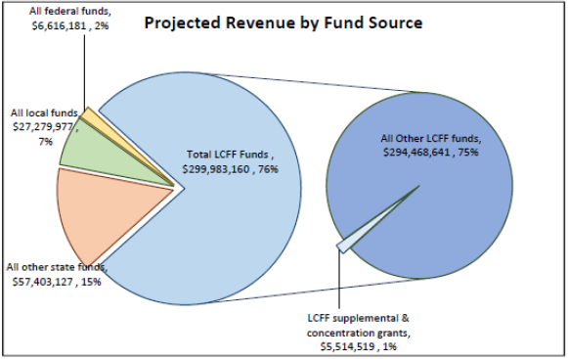
2022-23 LCAP Revenues

Slide 12
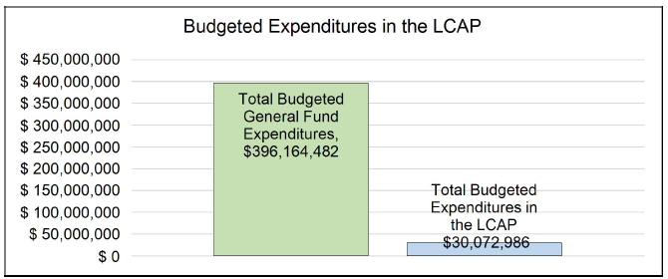
2022-23 LCAP Expenditures

Slide 13
Multi-Year Projection - 2022-23 Adopted Budget
 | 2022-23 | 2023-24 | 2024-25
Revenues | Budget | Projection | Projection
LCFF Sources | $299,983,160 | $302,230,235 | $303,300,579
Federal Revenue | $6,616,181 | $6,616,181 | $6,616,181
Other State Revenue | $57,403,127 | $49,931,568 | $48,981,421
Other Local Revenue | $27,279,977 | $27,282,468 | $27,297,745
Transfers In | $0 | $148,977 | $149,962
Total | $391,282,445 | $386,209,429 | $386,345,888
Expenditures
Certificated Salaries | $163,808,062 | $160,585,855 | $161,143,961
Classified Salaries | $58,973,953 | $58,748,943 | $59,265,672
Employee Benefits | $114,851,684 | $115,732,307 | $118,821,601
Books and Supplies | $13,242,805 | $9,794,845 | $9,776,786
Services | $44,143,982 | $41,490,549 | $41,617,788
Capital Outlay | $150,000 | $150,000 | $150,000
Other Outgo/Indirect Costs | $993,996 | $993,996 | $993,996
Transfers Out | $2,854,361 | $2,854,361 | $2,854,361
Total | $399,018,843 | $390,350,856 | $394,624,165
Net Increase (Decrease) in Fund Balance | ($7,736,398) | ($4,141,427) | ($8,278,277)

Slide 14
2022-23 Multi-Year Projection (MYP)
 | 2022-23 | 2023-24 | 2024-25
General Fund 01 Balance | Budget | Projection | Projection
Net Beginning Fund Balance | $33,250,880 | $25,514,482 | $21,373,055
Ending Fund Balance | $25,514,482 | $21,373,055 | $13,094,778
Components of Ending Fund Balance
-Non-spendable | $551,353 | $551,353 | $551,353
-Legally Restricted | $12,089,458 | $11,789,625 | $12,035,514
-Committed | $0 | $0 | $0
-Assigned | $12,873,670 | $9,032,076 | $507,910
-Undesignated/Unappropriated | $0 | $0 | $0
Total Ending Fund Balance | $25,514,482 | $21,373,055 | $13,094,778
Reserve for Economic Uncertainties (Fund 17)* | $11,970,565* | $11,710,525* | $11,838,725*
Declining Enrollment (Fund 17 Assigned) | $4,402,847 | $4,762,887 | $4,634,687
Reserve Percentage (Fund 17 Economic Uncertainty* + Fund 17 Assigned) | 4.12% | 4.22% | 4.17%
Ed. Effectiveness Grant: $5.4m
Lottery Instr. Materials: $608k
Classified Prof. Dev. Grant: $84k
ELO Grant: $1.5m
ELO Para Grant: $1m
Maintenance: $2m
Other Local Donations: $1.2m
Deficit Spending: $12.1m
Suppl. Services: $312k
Instr. Materials: $314k
Lottery Carryover: $91k
*Legally Required to maintain a reserve in the amount of 3% of annual expenditures

Slide 15
Review of MYP Ending Fund Balance
Required Reserves equal 3% of expenditures
“Reserve for Economic Uncertainty” resides in Fund 17
Assigned categories in General Fund 01 includes funds for:
Deficit Spending, Supplemental Services, Instructional Materials, and Lottery Carryover
Assigned amounts are one-time dollars, and total approximately $12.8m

Slide 16
Next Steps and Timeline
June 7: Public Hearing and review of the 2022-23 SRVUSD Budget
June 14: Action to adopt the 2022-23 SRVUSD Budget
June 30: Sacramento must adopt 2022-23 State Budget
August Board Meeting: “45 Day Budget Revision” to align the SRVUSD district budget with the state budget
August to October: review actual enrollment numbers
December: 2022-23 First Interim Financial Report to check our assumptions

Slide 17
Update on State Budget Process
Since the May Revise, the state budget negotiations continue:
The Legislature (Senate and Assembly) published their budget on June 1st.
Their budget confirms some of the Governor’s proposals.
Some of the Governor’s proposals were rejected.
The Legislature made some counter proposals.
The next few slides attempt to summarize the differences between the Governor’s May Revise and the Legislature’s proposals as outlined in AB 154 and SB 154.

Slide 18
Update on State Budget Process
Item | May Revise (5.13.22) | Legislative Budget (6.1.22)
LCFF Base Funding | COLA of 6.56% $11.5 million* Increase the base by $2.1billion $10 million* | Accepts COLA Accepts base increase Proposes additional $4.5 billion $17 million* Adds homelessness to the definition of unduplicated Increases poverty threshold to 250%
Declining Enrollment / ADA Relief | 3-year rolling average for ADA Replace the 2021-22 attendance rate with 2019-20 rate | Accepts 3-year average Rejects attendance rate replacement
*Green text highlights the approximate amount of funds SRVUSD could expect to see from the listed proposal.
Notes:
by including homeless students explicitly in unduplicated pupil counts and by expanding the definition of low-income to include families with income at or below the 250% federal poverty level

Slide 19
Update on State Budget Process
Item | May Revise (5.13.22) | Legislative Budget (6.1.22)
Learning Recovery Discretionary Block Grant | $8 billion one-time funds $39 million* Full discretion (with intent language) Allocated per pupil and spent over 7 years | Accept $8 billion one-time funds Increase up to $8.5 billion $41 million limited uses: “salaries, benefits, and employer contributions to benefit and pension costs” Accept the timeline and allocation type
*Green text highlights the approximate amount of funds SRVUSD could expect to see from the listed proposal.

Slide 20
Update on State Budget Process
Item | May Revise | Legislative Budget
Expanded Learning Opportunities Program | Several implementation changes $4.8 billion in funding $2,500 per eligible student $3.5 million One-time $1 billion for infrastructure | Accept implementation changes $4.4 billion (Gov. Budget from Jan) Two-tier funding structure, $3,000 / $1,500 per eligible student (determined by district being above of below 75% UPP) $2.1 million Rejects and instead creates the Arts, Music, Instructional Materials and Libraries Block Grant
*Green text highlights the approximate amount of funds SRVUSD could expect to see from the listed proposal.
Notes:
ELO: extend the grace period for implementation by one year, delaying the audit and allowing carryover until 2023-24, adopts pro-rated penalties for audit findings,
UPP = 2881 in 2022-23

Slide 21
Update on State Budget Process
Item | May Revise | Legislative Budget
Home to School Transportation | No new funding or new requirements | $1.2 billion Districts required to offer to grades TK-6, low income students beginning in 2027-28
School Nutrition | Universal school meals, $650 million ongoing Increasing reimbursement rate, $611 million ongoing $450 million for infrastructure | Accepts Accepts Adds $250 one-time to infrastructure
Notes:
ELO: extend the grace period for implementation by one year, delaying the audit and allowing carryover until 2023-24, adopts pro-rated penalties for audit findings,
UPP = 2881 in 2022-23

Slide 22
Next Steps and Timeline
June 7: Public Hearing and review of the 2022-23 SRVUSD Budget
June 14: Action to adopt the 2022-23 SRVUSD Budget
June 30: Sacramento must adopt 2022-23 State Budget
August Board Meeting: “45 Day Budget Revision” to align the SRVUSD district budget with the state budget
August to October: review actual enrollment numbers
December: 2022-23 First Interim Financial Report to check our assumptions

Slide 23
Thank You

